Slide 1
Computer Organization and Assembly Language Lecture 7

Slide 2
Agenda
Today’s topics:
Shift Instructions
Decision making instructions

Slide 3
Shift Instructions
These instructions move all the bits in a word to the left or right, filling the emptied bits with 0s
The actual name of two MIPS shift instructions are called
Shift left logical (sll) (in c <<)
Shift right logical (srl) (in c >>)
For example, if the $s0 contains
(0000 0000 0000 0000 0000 0000 0000 1001)_{two}⁼9₁₀
The instruction to shift left by 4 was executed and the new value would be:
(0000 0000 0000 0000 0000 0000 1001 0000)_{two}=144₁₀

Slide 4
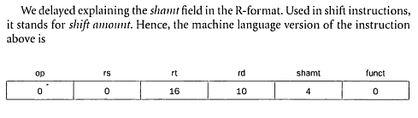
Shift Instructions
The following instruction performs shift operation, assuming that the original value was in register $s0 and the result should go in register $t2.
sll $t2,$s0,4 #reg $t2=reg $s0 << 4 bits

Slide 5
Control: Decision making instructions
What distinguishes a computer from a simple calculator is its ability to make decisions
Based on the input data and the values created during computation, different instructions execute.
Decision making is commonly represented in computer using if statement, sometimes combined with goto statement and Labels

Slide 6
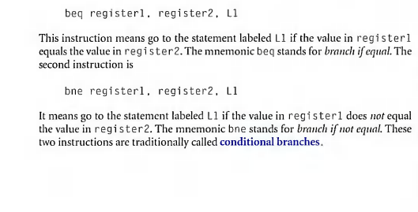
Control

Slide 7
Control: Conditional Branch
Example: if (i==j) h = i + j; bne $s0, $s1, Label add $s3, $s0, $s1 Label: ....

Slide 8
Control
MIPS unconditional branch instructions: j label
Example: if (i!=j) beq $s4, $s5, Lab1 h=i+j; add $s3, $s4, $s5 else j Lab2 h=i-j; Lab1: sub $s3, $s4, $s5 Lab2: ...

Slide 9
So Far We’ve Learned
Instruction Meaning add $s1,$s2,$s3 $s1 = $s2 + $s3 sub $s1,$s2,$s3 $s1 = $s2 – $s3 lw $s1,100($s2) $s1 = Memory[$s2+100] sw $s1,100($s2) Memory[$s2+100] = $s1 bne $s4,$s5,Label Next instr. is at Label if $s4 ≠ $s5 beq $s4,$s5,Label Next instr. is at Label if $s4 = $s5 j Label Next instr. is at Label
Formats:
R
I
J
op rs rt rd shamt funct
op rs rt 16 bit address
op 26 bit address

Slide 10

Procedure Calling

Slide 11
Three Ways to Jump: j, jr, jal
j instr # jump to machine instruction instr
(unconditional jump)
jr $ra # jump to address in register ra
(used by calee to go back to caller)
jal addr # set $ra = PC+4 and go to addr
(jump and link; used to jump to a procedure)
Jal is used to call subroutine, it is “jump and link” instruction

Slide 12
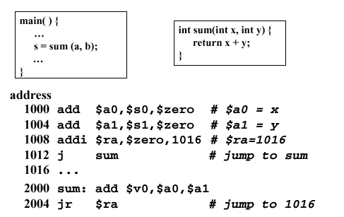
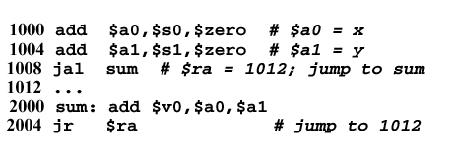
Q: Why two add instructions are used instead of using li to load value in register?
Ans: these instructions are used to put the arguments of sum into argument registers $a0 and $a1
This code can be made more efficient
by using jal instruction

Slide 13
Control Flow
We have: beq, bne, what about Branch-if-less-than?
New instructions: slt and slti
Slt: set if less then if $s1 < $s2 then $t0 = 1 slt $t0, $s1, $s2 else $t0 = 0
slti if $s2 < 10 then $t0 = 1 slti $t0, $s2, 10 else $t0 = 0

Slide 14
Assembly Language vs. Machine Language
Assembly provides convenient symbolic representation
much easier than writing down numbers
e.g., destination first
Machine language is the underlying reality
e.g., destination is no longer first
Assembly can provide 'pseudoinstructions'
e.g., “move $t0, $t1” exists only in Assembly
implemented using “add $t0, $t1, $zero”
When considering performance you should count real instructions and clock cycles

Slide 15
Overview of MIPS
simple instructions, all 32 bits wide
very structured, no unnecessary baggage
only three instruction formats
rely on compiler to achieve performance
op rs rt rd shamt funct
R
I
J
op rs rt 16 bit address
op 26 bit address

Slide 16
Addresses in Branches and Jumps
Instructions:
bne $t4, $t5, Label Next instruction is at Label if $t4 ≠ $t5
beq $t4, $t5, Label Next instruction is at Label if $t4 = $t5
j Label Next instruction is at Label
Formats:
op rs rt 16 bit rel. address
I
J
op 26 bit absolute address

Slide 17
Addresses in Branches
Instructions:
bne $t4,$t5,Label Next instruction is at Label if $t4 ≠ $t5
beq $t4,$t5,Label Next instruction is at Label if $t4 = $t5
Formats:
Relative addressing
with respect to PC (program counter)
most branches are local (principle of locality)
op rs rt 16 bit address
op 26 bit address

Slide 18
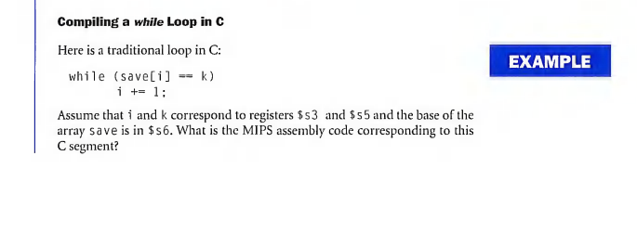
Example: Loop in C

Slide 19
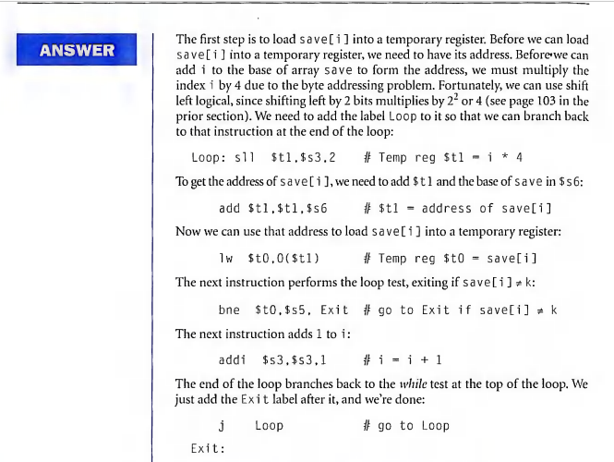

Slide 20
Machine Code and Mem. Addresses
Memory Machine code
Byte addr. Bits 31-26| 25-21 | 20-16 | 15-11 | 10 – 6 | 5 – 0 |
80000
80004
80008
80012
80016
80020
80024
0 | 0 | 19 | 9 | 2 | 0
0 | 9 | 22 | 9 | 0 | 32
35 | 9 | 8 | 0
5 | 8 | 21 | Exit = +2
8 | 19 | 19 | 1
2 | Loop = 20000 (memory word address)
. . . . .
sll
add
lw
bne
addi
j
Note: $t0 ≡ Reg 8, $t1 ≡ Reg 9, $s3 ≡ Reg 19, $s5 ≡ Reg 21, $s6 ≡ Reg 22
temp temp i k save

Slide 21
Finding Branch Address Exit
Exit = +2 is a 16 bit integer in bne instruction
000101 01000 10101 0000000000000010 = 2
$PC = 80016 is the byte address of the next instruction
00000000000000010011100010010000 = 80016
Multiply bne argument by 4 (convert to byte address)
0000000000001000 = 8
$PC ← $PC + 8
00000000000000010011100010011000 = 80024
Thus, Exit is memory byte address 80024.

Slide 22
Finding Jump Address Loop
J 20000
000010 00000000000100111000100000 = 20000
$PC = 80024, when jump is being executed
00000000000000010011100010011000 = 80024
Multiply J argument by 4 (convert to byte address)
0000000000010011100010000000 = 80000
Insert four leading bits from $PC
00000000000000010011100010000000 = 80000
Thus, Loop is memory byte address 80000.

Slide 23
Summary: MIPS Registers and Memory

Slide 24
Summary: MIPS Instructions

Slide 25
Addressing Modes
Example
addi
add
lw, sw
beq, bne
j

Slide 26
Summary
Instruction complexity is only one variable
lower instruction count vs. higher CPI / lower clock rate – we will see performance measures later
Design Principles:
simplicity favors regularity
smaller is faster
good design demands compromise
make the common case fast
Instruction set architecture
a very important abstraction indeed!
Links to some instruction sets – next slide.

Slide 27
Some Instruction Sets
MIPS
http://www.d.umn.edu/~gshute/mips/MIPS.html
ARM
http://simplemachines.it/doc/arm_inst.pdf
IA32/64
http://brokenthorn.com/Resources/OSDevX86.html
PowerPC
http://pds.twi.tudelft.nl/vakken/in101/labcourse/instruction-set/
SPARC
http://www.cs.unm.edu/~maccabe/classes/341/labman/node9

